Slide 1
PROJECT FOUR
Web Scraping Job Postings

Slide 2

WEB SCRAPING
Scraped seek.com.au
Scrapy Xpath selector
Melbourne and Sydney
1200jobs down to 750 after duplicates removed

Slide 3
WEB SCRAPING
Split jobs by Experience, Title and Salary
Experience - Junior, Middle, Senior
Title - Analyst, Scientist, Engineer, Consultant and Other
Salary - Low, Med and High
Lots of missing salary data
Matched missing cells by Title and Experience
Replaced missing value with median value for subset

Slide 4
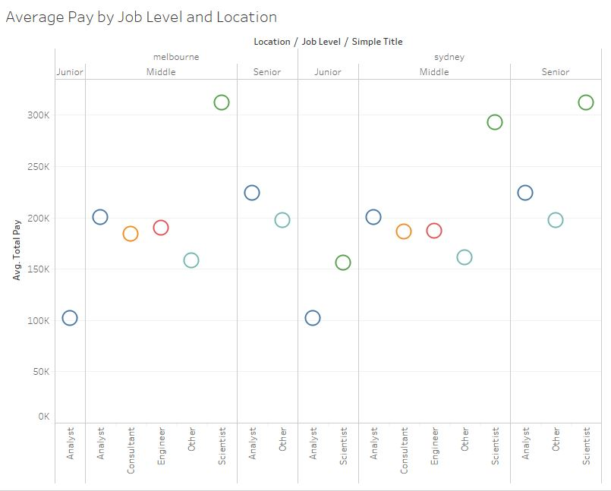
EDA

Slide 5
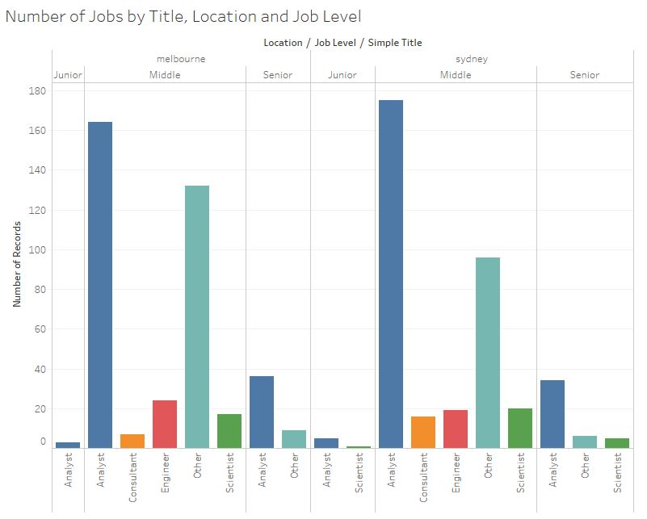
EDA

Slide 6
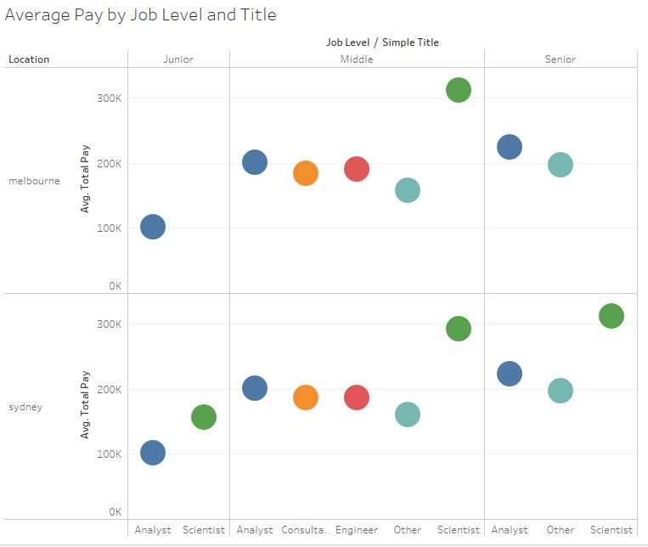
EDA

Slide 7
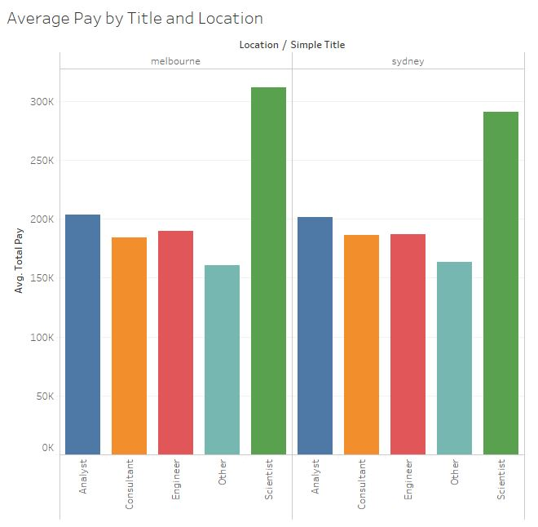
EDA

Slide 8
FACTORS THAT IMPACT SALARY
Vectorizers
CountVectorizer
TF-IDF
Models
Multinomial Naive Bayes
Logistic Regression
Support Vector Classifier (SVC)
Random Forest
Predicters
Description
Title
Location
Combination of Title, Location and Job Level

Slide 9

FACTORS THAT IMPACT SALARY
Classification
3 bins for salary
Baseline = 51.36%

Slide 10

FACTORS THAT IMPACT SALARY
Generally count vectorizer produced better results than TF-IDF
Logistic Regression and Random Forest outperfomed the other models
Best predicter was the combination of Title, Location and Job Level

Slide 11
FACTORS THAT IMPACT SALARY
High
Job Level = Senior
Title = Scientist
Med
Job Level = Middle
Title = Analyst, Consultant, Engineer
Low
Job Level = Junior
Title = Other

Slide 12
FACTORS THAT DISTINGUISH JOB CATEGORY
Classification
5 options
Analyst
Engineer
Scientist
Consultant
Other
Baseline = 54.22%

Slide 13
FACTORS THAT DISTINGUISH JOB CATEGORY
Logistic Regression with Count Vectorizer produced the best result as 73.57%
Random Forest with TF-IDF was the next best at 61.65%
All models actually outperformed the baseline

Slide 14
FACTORS THAT DISTINGUISH JOB CATEGORY
?

